Slide 1


Flatworm
Watch
Engaging gardeners on biological invasions
Arnaud Jacobs
National Scientific Secretariat on Invasive Alien Species
Inspiration Day CS, 30 May 2024

Slide 2

















































Context
Biological invasions, among most important drivers of biodiversity loss
EU Regulation on Invasive Alien species
  List of species of Union concern
  Obligations of Prevention, Early warning, Management

Slide 3
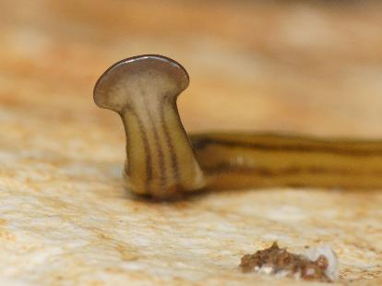
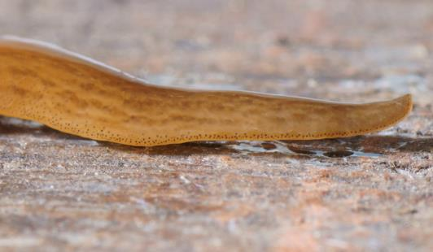
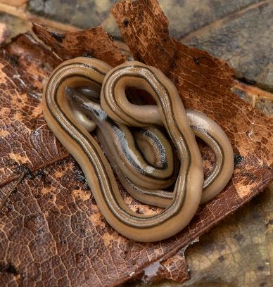
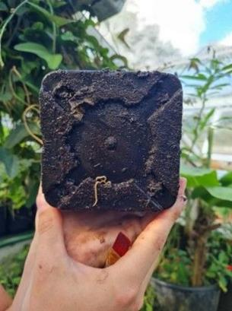
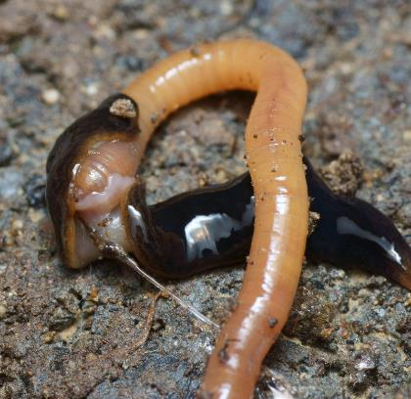
Context
Flatworms
  Native and Non-native
    One Union list species
  Introduction via plants imports
  Predators
  Impact on soil fauna
© Pierre Gros
© Pierre Gros
© EIS Kenniscentrum Insecten
© Sytske de Waart
© Pierre Gros

Slide 4
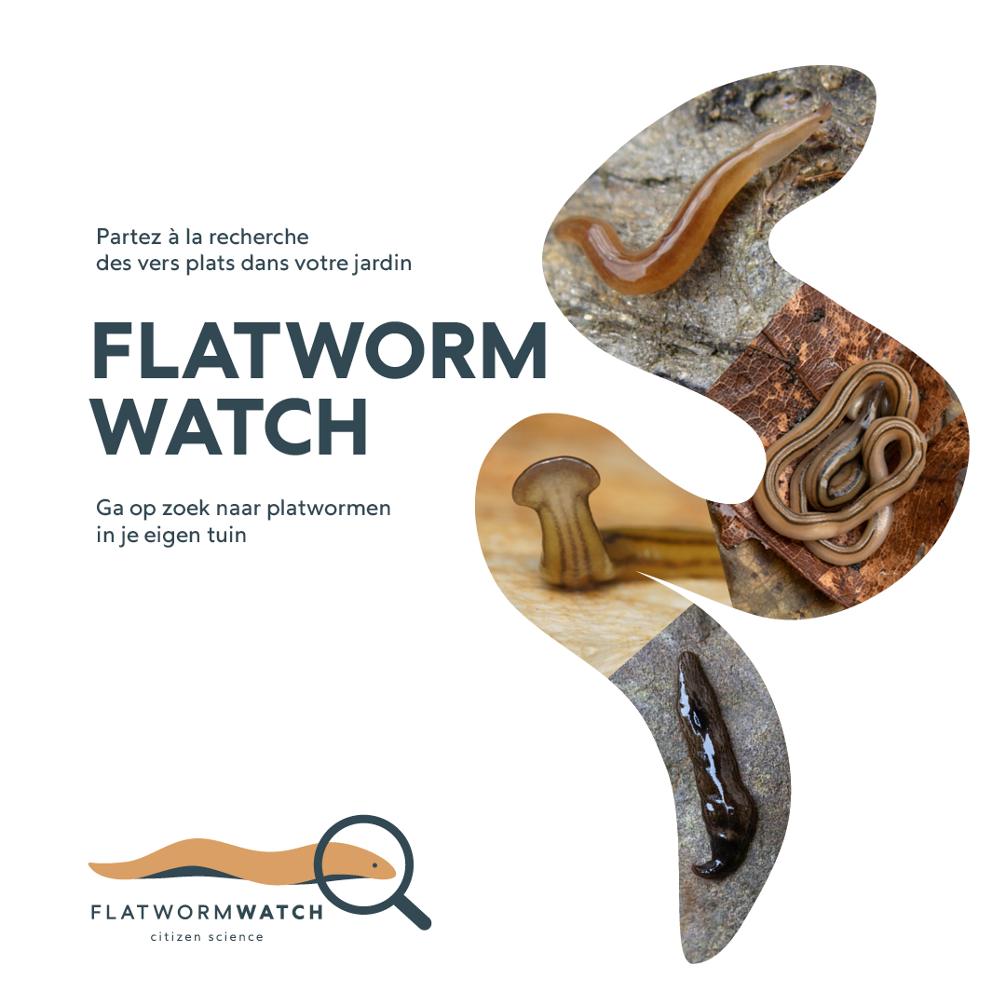
Objectives
Gain a better view on the issue of non-native flatworms in Belgium
  Species identity
  Distribution
  Pathways
  Genetics
Raise awareness on biological invasions
Evaluate the potential of citizen science for monitoring unknown species

Slide 5
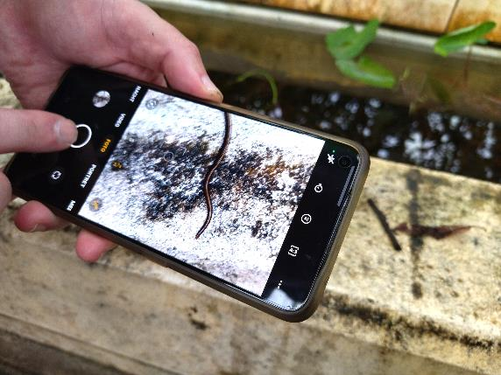


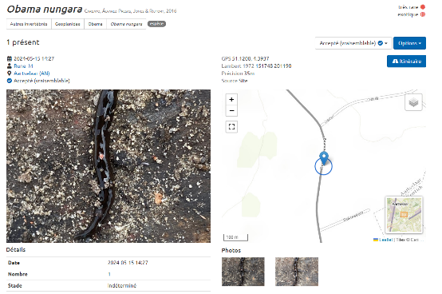
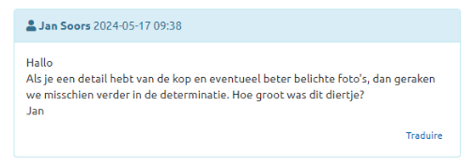
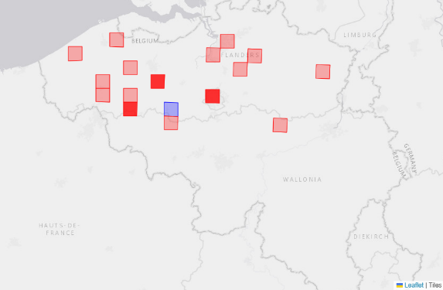
Protocol
We ask participants to:
Search for flatworms
Take pictures
Try to identify them
Encode their observations
The project team will:
Validate observations
Provide feedbacks
Takes samples if necessary
Synthesize results

Slide 6
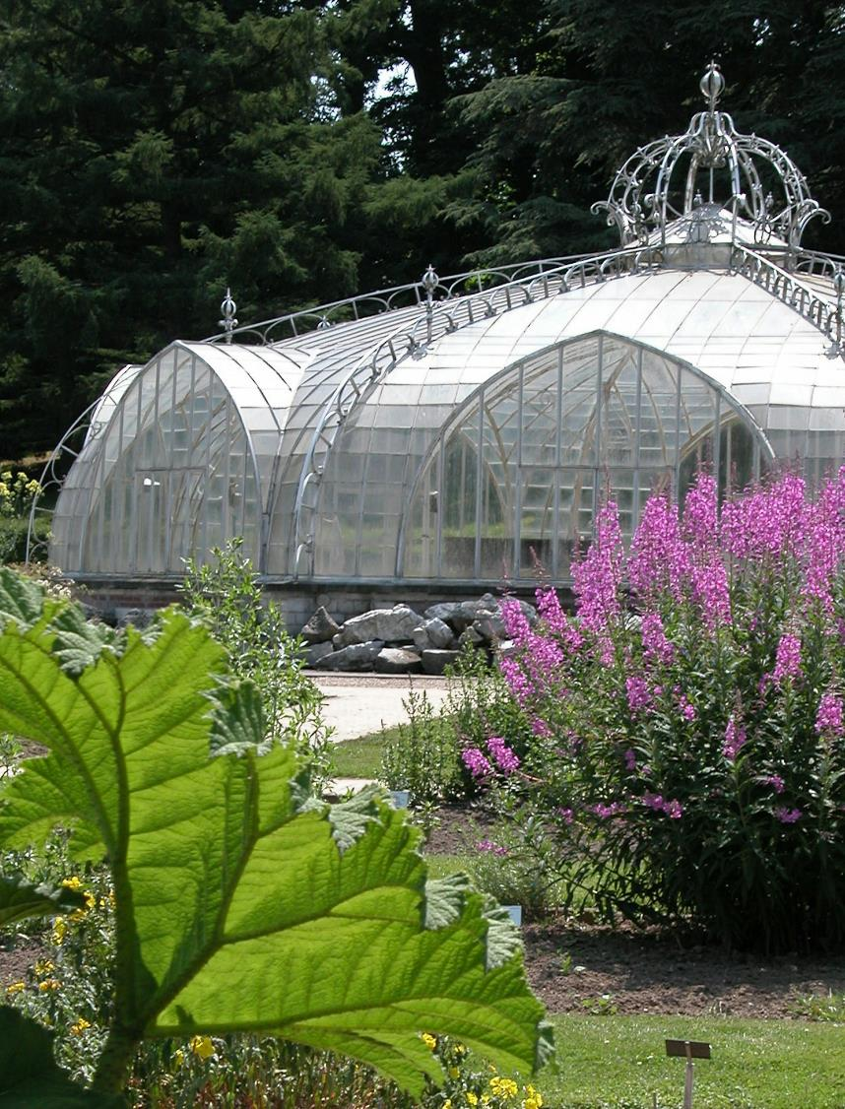
Community
Target audience
Gardeners
Naturalists
Terrarium hobbyists
Visitors of botanic gardens
Mapping
Questions on profile in registration form

Slide 7
Communication strategy
REACHING OUT
Social media and mailing
Naturalists: RBINS, INBO, Natagora, Natuurpunt, CNB, Contrats Rivière, Botanic gardens,…
Citizen scientists: Mijntuinlab, Scivil, Iedereen wetenschapper
Gardeners and terrarium: Facebook groups, Federations, Magazines
ENGAGING FLATWORMWATCHERS
Newsletter
Feedbacks on Waarnemingen.be
Online training
  Creation of a core group?
Visit in Meise
Results: Maps and highlights

Slide 8
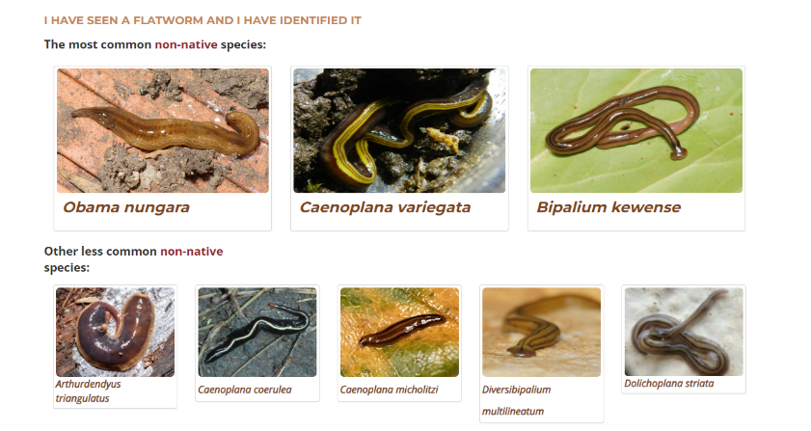

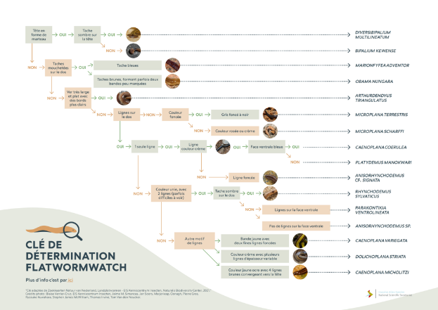
Tools
Portal for encoding observations
Guidelines
ID Key
Feedback via Observations.be/Waarnemingen.be
Collect samples if needed

Slide 9
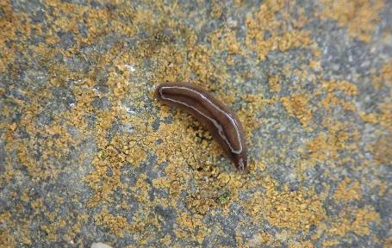
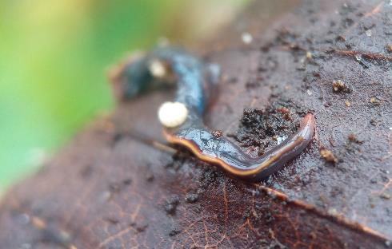
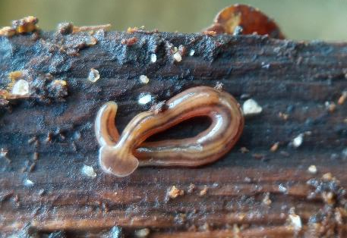
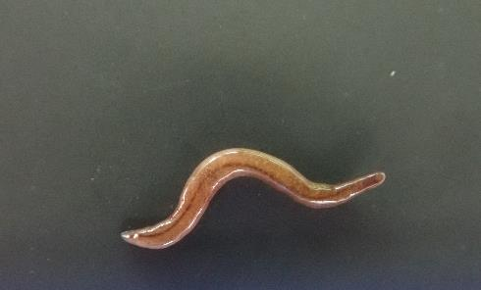
Challenges
Sample collection
Treatment of observations
Keeping the community engaged
  Rare species
Limited support and interdisciplinarity
1st Citizen Science project
Pictures: Jan Soors, Tom Van den Neucker

Slide 10
Thank you!
www.iasregulation.be/flatwormwatch
Thank you for your attention !
23.10.2023

